Slide 1
Topic 3 PROPERTIES OF PURE SUBSTANCES
Thermodynamics: An Engineering Approach
8th Edition Yunus A. Çengel, Michael A. Boles
McGraw-Hill, 2015

Slide 2
Objectives
Introduce the concept of a pure substance.
Discuss the physics of phase-change processes.
Define compressed and saturation liquid.
Define saturated and superheated vapor.
Discuss effects of temperature and pressure on phase changes.
Illustrate the P-v, T-v, and P-T property diagrams and P-v-T surfaces of pure substances.
Demonstrate the procedures for determining thermodynamic properties of pure substances from tables of property data.

Slide 3
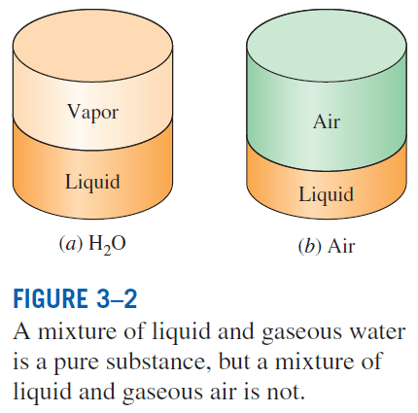
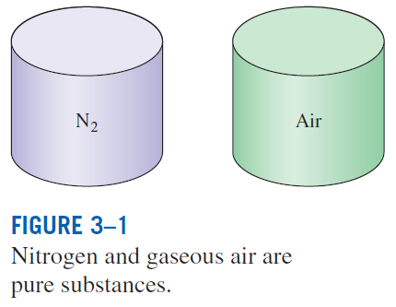
PURE SUBSTANCE
Pure substance: A substance that has a fixed chemical composition throughout.
Air is a mixture of several gases, but it is considered to be a pure substance.
Notes:
Composition of liquid air is different from that of gaseous air

Slide 4
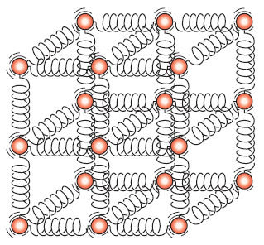
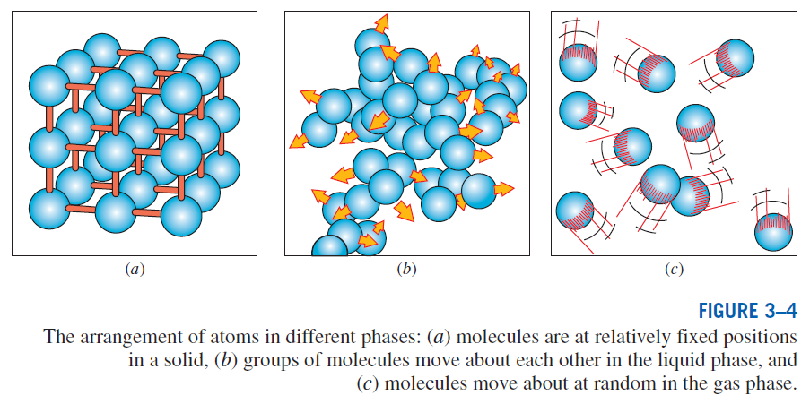
PHASES OF A PURE SUBSTANCE
The molecules in a solid are kept at their positions by the large springlike inter-molecular forces.

Slide 5
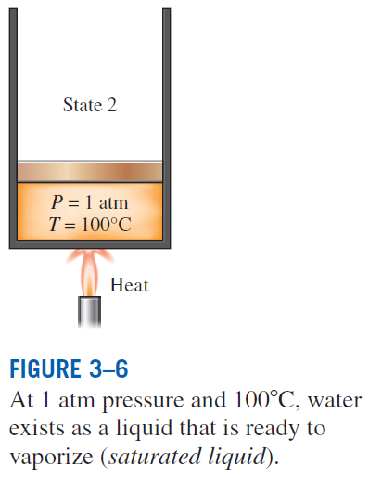
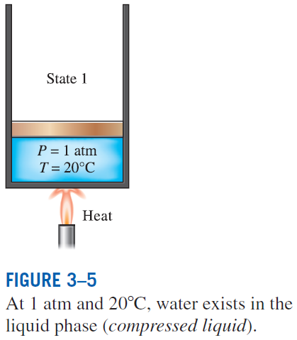
PHASE-CHANGE PROCESSES OF PURE SUBSTANCES
Compressed liquid (subcooled liquid): A substance that it is not about to vaporize
Saturated liquid: A liquid that is about to vaporize

Slide 6
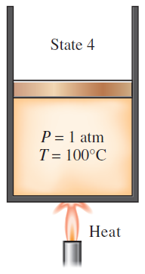
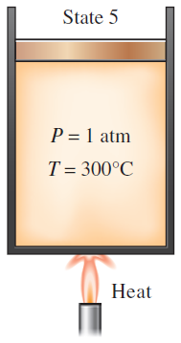
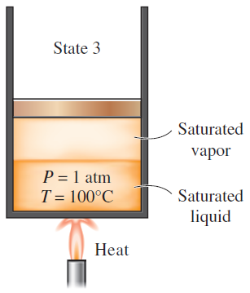
Saturated vapor: A vapor that is about to condense.
Saturated liquid–vapor mixture: The state at which the liquid and vapor phases coexist in equilibrium.
Superheated vapor: A vapor that is not about to condense (i.e., not a saturated vapor).
At 1 atm pressure, the temperature remains constant at 100°C until the last drop of liquid is vaporized (saturated vapor).
As more heat is transferred, the temperature of the vapor starts to rise (superheated vapor).
As more heat is transferred, part of the saturated liquid vaporizes (saturated liquid–vapor mixture).

Slide 7
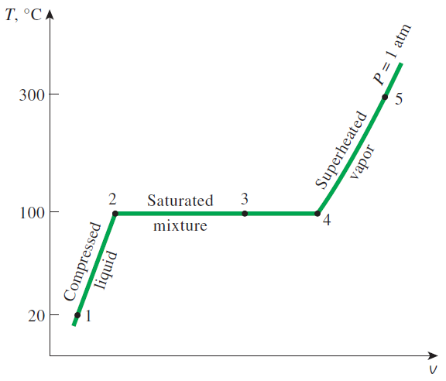
If the entire process between state 1 and 5 is reversed by cooling the water while maintaining the pressure at the same value, the water will go back to state 1, retracing the same path, and in so doing, the amount of heat released will exactly match the amount of heat added during the heating process.
T-v diagram for the heating process of water at constant pressure.
Notes:
V1 = .0009996 m^3/kg
V2 = .001040 m^3/kg
V3 = ??
V4 = 1.7 m^3/kg
V5 = 7.26 m^3/kg (at 1300 C)

Slide 8
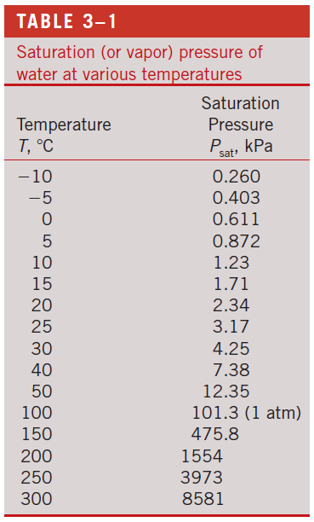
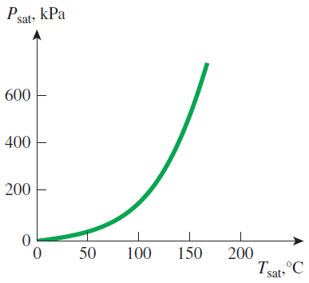
Saturation Temperature and Saturation Pressure
The temperature at which water starts boiling depends on the pressure; therefore, if the pressure is fixed, so is the boiling temperature.
Water boils at 100°C at 1 atm pressure.
Saturation temperature T_{sat}: The temperature at which a pure substance changes phase at a given pressure.
Saturation pressure P_{sat}: The pressure at which a pure substance changes phase at a given temperature.
The liquid–vapor saturation curve of a pure substance (numerical values are for water).

Slide 9
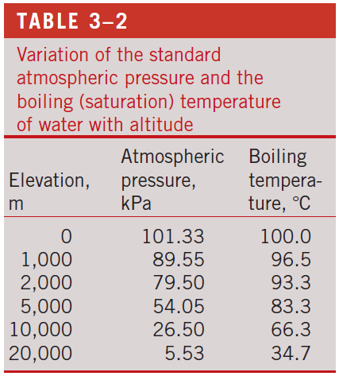
Latent heat: The amount of energy absorbed or released during a phase-change process.
Latent heat of fusion: The amount of energy absorbed during melting. It is equivalent to the amount of energy released during freezing.
Latent heat of vaporization: The amount of energy absorbed during vaporization and it is equivalent to the energy released during condensation.
The magnitudes of the latent heats depend on the temperature or pressure at which the phase change occurs.
At 1 atm pressure, the latent heat of fusion of water is 333.7 kJ/kg and the latent heat of vaporization is 2256.5 kJ/kg.
The atmospheric pressure, and thus the boiling temperature of water, decreases with elevation.

Slide 10
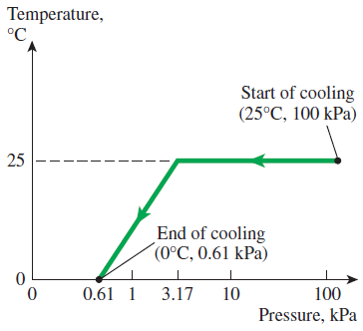
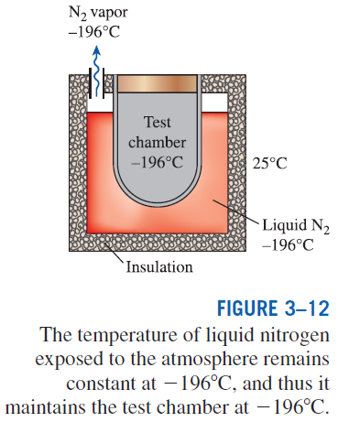
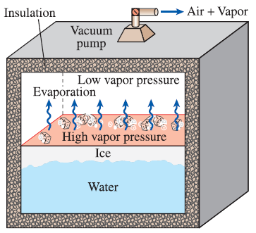
Some Consequences of T_{sat} and P_{sat} Dependence
The variation of the temperature of fruits and vegetables with pressure during vacuum cooling from 25°C to 0°C.
In 1775, ice was made by evacuating the air space in a water tank.
Notes:
Any heat transfer from environment to test chamber is absorbed by liquid nitrogen until the nitrogen is depleted.
In vacuum cooling (used when you need to cool something FAST), 2 stages: 1st – reduce pressure (temp stays constant) until saturation pressure is reached, which is 3.17 kPa at 25C. 2nd – keep saturated conditions; lower pressure leads to lower temperature of food.

Slide 11
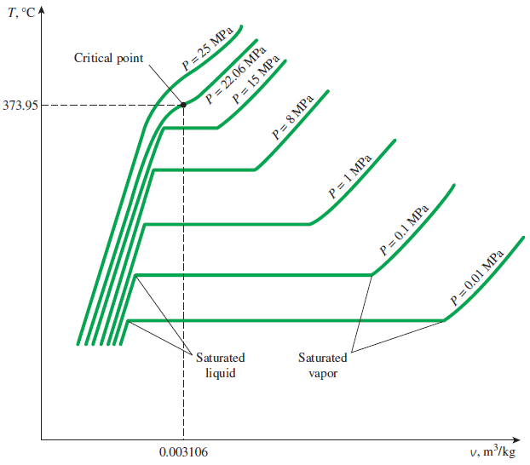
PROPERTY DIAGRAMS FOR PHASE-CHANGE PROCESSES
The variations of properties during phase-change processes are best studied and understood with the help of property diagrams such as the T-v, P-v, and P-T diagrams for pure substances.
T-v diagram of constant-pressure phase-change processes of a pure substance at various pressures (numerical values are for water).

Slide 12
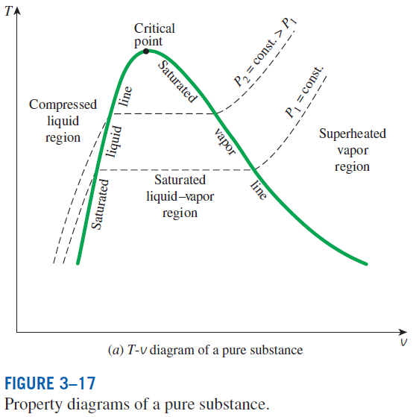
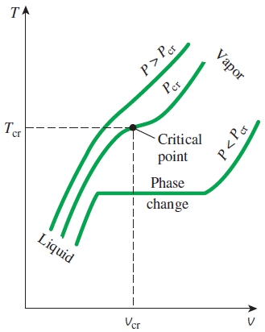
saturated liquid line
saturated vapor line
compressed liquid region
superheated vapor region
saturated liquid–vapor mixture region (wet region)
At supercritical pressures (P > P_{cr}), there is no distinct phase-change (boiling) process.
Critical point: The point at which the saturated liquid and saturated vapor states are identical.

Slide 13
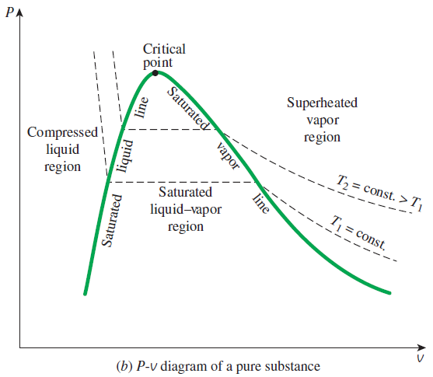
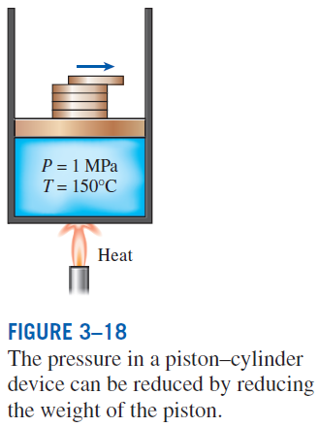

Slide 14
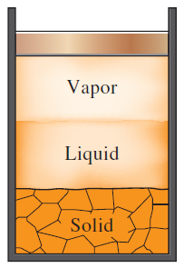
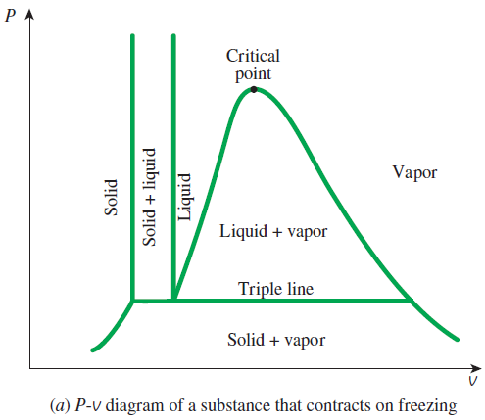
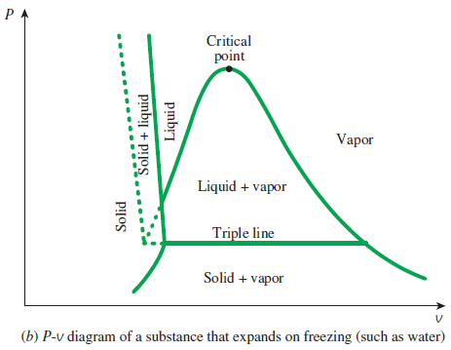
Extending the Diagrams to Include the Solid Phase
For water,
T_{tp} = 0.01°C
P_{tp} = 0.6117 kPa
At triple-point pressure and temperature, a substance exists in three phases in equilibrium.

Slide 15
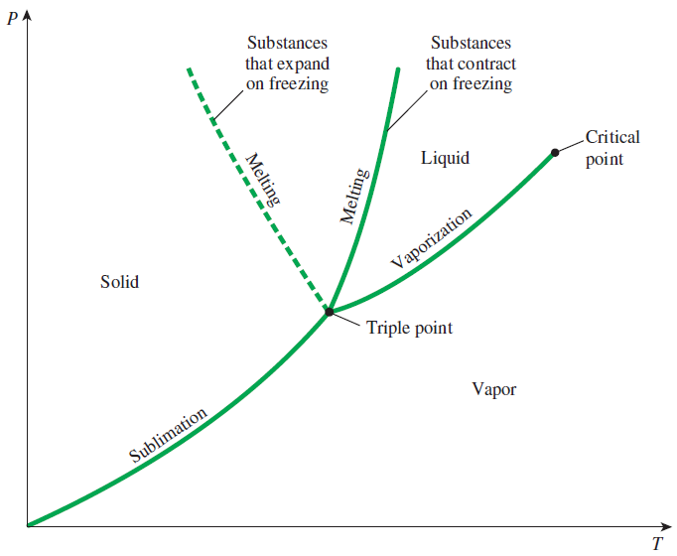
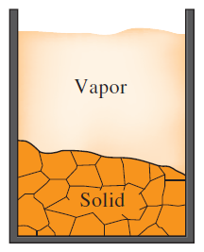
Phase Diagram
Sublimation: Passing from the solid phase directly into the vapor phase.
At low pressures (below the triple-point value), solids evaporate without melting first (sublimation).
P-T diagram of pure substances.

Slide 16
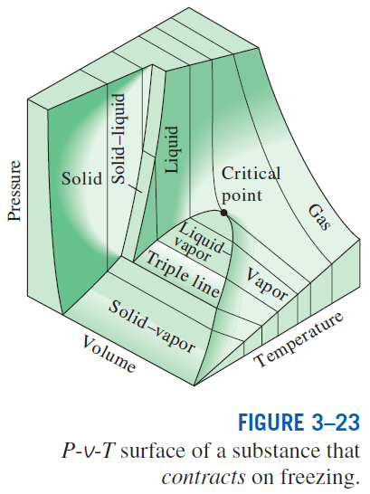
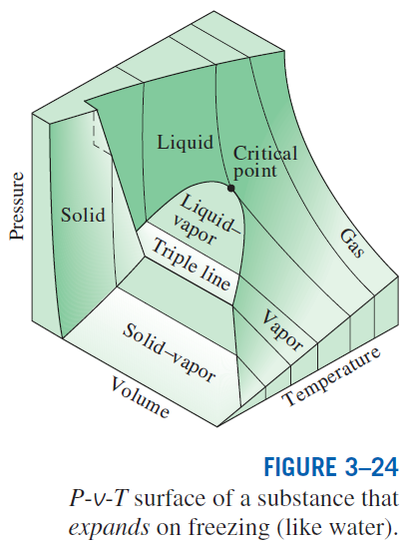
The P-v-T surfaces present a great deal of information at once, but in a thermodynamic analysis it is more convenient to work with two-dimensional diagrams, such as the P-v and T-v diagrams.

Slide 17
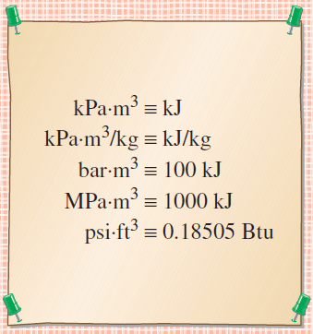
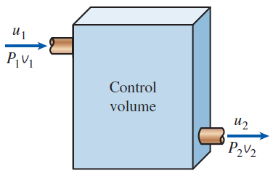
PROPERTY TABLES
For most substances, the relationships among thermodynamic properties are too complex to be expressed by simple equations.
Therefore, properties are frequently presented in the form of tables.
Some thermodynamic properties can be measured easily, but others cannot and are calculated by using the relations between them and measurable properties.
The results of these measurements and calculations are presented in tables in a convenient format.
Enthalpy—A Combination Property
The combination u + Pv is frequently encountered in the analysis of control volumes.
The product pressure × volume has energy units.

Slide 18
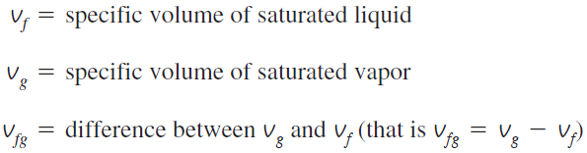
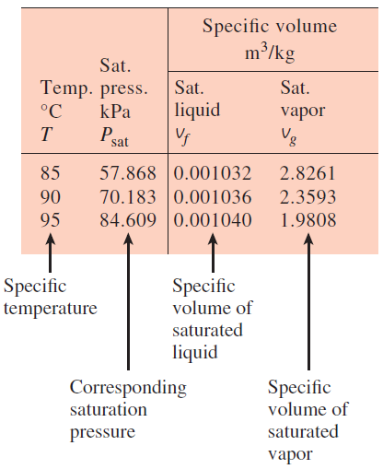
Saturated Liquid and Saturated Vapor States
A partial list of Table A–4.
Table A–4: Saturation properties of water under temperature.
Table A–5: Saturation properties of water under pressure.
Enthalpy of vaporization, h_{fg} (Latent heat of vaporization): The amount of energy needed to vaporize a unit mass of saturated liquid at a given temperature or pressure.

Slide 19
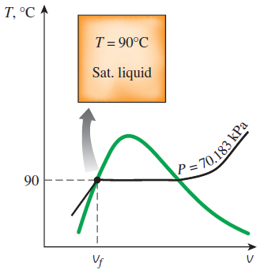
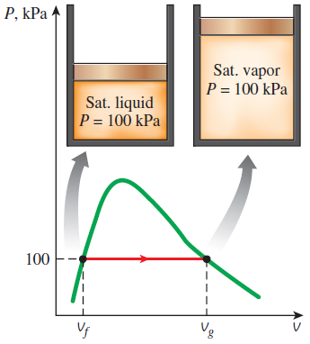
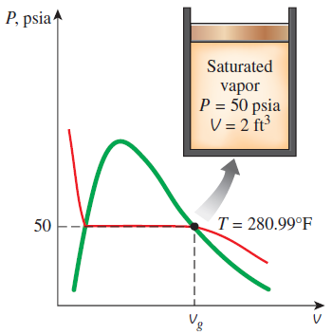
Examples: Saturated liquid and saturated vapor states of water on T-v and P-v diagrams.
Notes:
Top left: Example 3-1, p. 125
Bottom: Example 3-2, p. 126
Top Right: Example 3-3, p. 126

Slide 20
Some more examples
What is the pressure and specific volume for a saturated liquid at 70ºC?
P_{sat} = 31.202 kPa v_{f} = 0.001023 m³/kg
At what temperature does a container with liquid water and water vapor at 200 psia exist?
T_{sat} = 381.80 ºF
Determine the amount of energy (per mass) needed to boil water at 80ºC and 47.416 kPa.
h_{fg} = 2308 kJ/kg
What is the pressure of a container that contains 2 kg of a saturated liquid of refigerant-134a (R-134a) at -10ºC?
P_{sat} =200.74 kPa

Slide 21
Determine the specific volume of a saturated vapor of water at 93ºC.
There’s no data for it. How can we determine the specific volume?
We use interpolation.
Find two points (one on each side of the value we are examining). So in this case we want to look at 90ºC and 95ºC.
Let’s plot the temperatures and specific volumes and assume that the two points can be connected by a line.
v
1
2
T

Slide 22

Interpolation
If we assume that our third point (the point we are interested in) is located on the line, then the slope of the line from 1 to 2 is the same as 2 to 3 (or 1 to 3)
$$m_{12}=\frac{v_{2}−v_{1}}{T_{2}−T_{1}}$$
$$m_{23}=\frac{v_{3}−v_{2}}{T_{3}−T_{2}}$$
$$m_{12}=m_{23}$$
$$\frac{v_{2}−v_{1}}{T_{2}−T_{1}}=\frac{v_{3}−v_{2}}{T_{3}−T_{2}}$$
$$v_{3}=\frac{v_{2}−v_{1}}{T_{2}−T_{1}}\left(T_{3}−T_{2}\right)+v_{2}$$
v
1
3
2
T

Slide 23
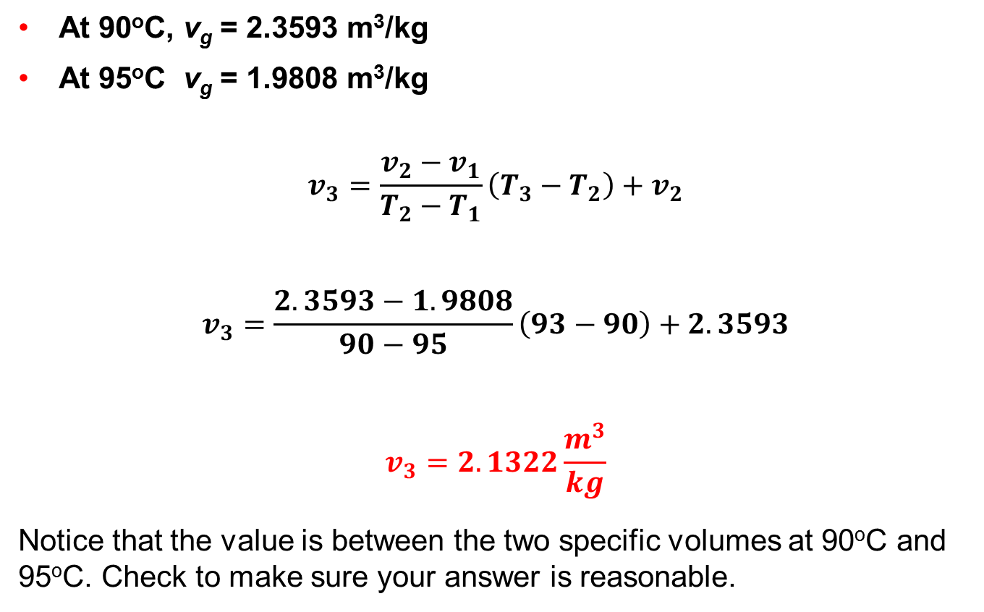
Determine the specific volume of a saturated vapor of water at 93ºC.
At 90ºC, v_{g} = 2.3593 m³/kg
At 95ºC v_{g} = 1.9808 m³/kg
$$v_{3}=\frac{v_{2}−v_{1}}{T_{2}−T_{1}}\left(T_{3}−T_{2}\right)+v_{2}$$
$$v_{3}=\frac{2.3593−1.9808}{90−95}\left(93−90\right)+2.3593$$
$$v_{3}=2.1322\frac{m^{3}}{kg}$$
Notice that the value is between the two specific volumes at 90ºC and 95ºC. Check to make sure your answer is reasonable.

Slide 24
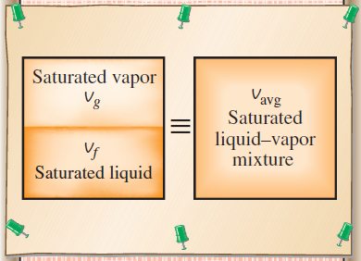
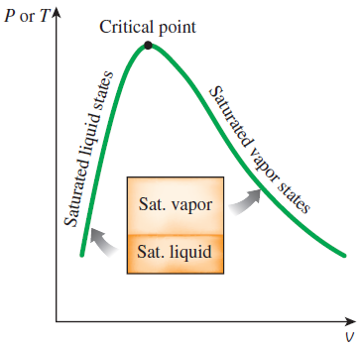
Saturated Liquid–Vapor Mixture
Quality, x : The ratio of the mass of vapor to the total mass of the mixture. Quality is between 0 and 1 0: sat. liquid, 1: sat. vapor.
The properties of the saturated liquid are the same whether it exists alone or in a mixture with saturated vapor.
Temperature and pressure are dependent properties for a mixture.
The relative amounts of liquid and vapor phases in a saturated mixture are specified by the quality x.
A two-phase system can be treated as a homogeneous mixture for convenience.

Slide 25
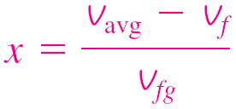
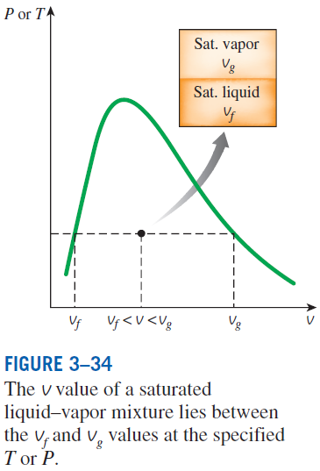
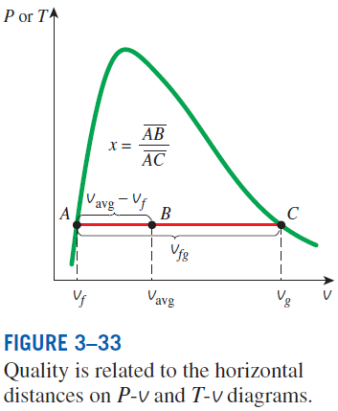
y v, u, or h.

Slide 26
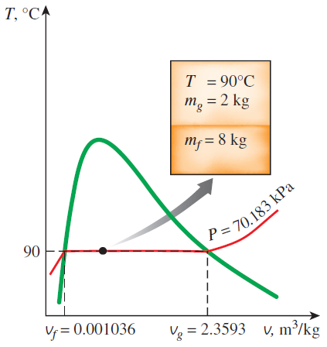


Example: Saturated liquid-vapor mixture states on T-v and P-v diagrams.
$$ν_{avg}=?$$
$$ν_{avg}=0.473\frac{m^{3}}{kg}$$

Slide 27
Example
Determine the pressure and volume of a rigid container that contains 10 lbm of water at 150ºF where water in the liquid form has a mass of 7 lbm.
Example 1

Slide 28
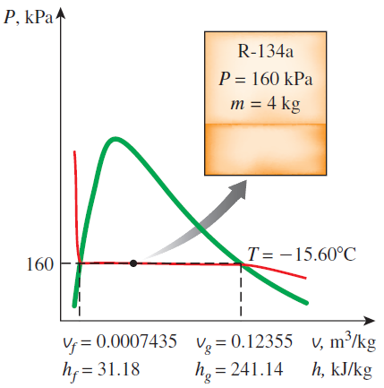
Example
A 100 L container contains 4 kg of R-134a at a pressure 160 kPa. Determine the temperature, the quality, and the enthalpy of the refrigerant.
Example 2

Slide 29
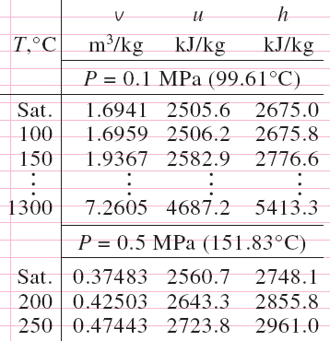
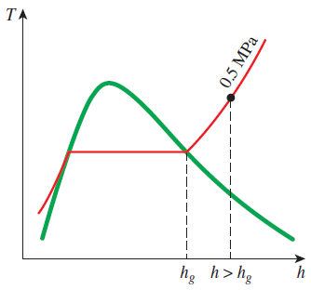
Superheated Vapor
In the region to the right of the saturated vapor line and at temperatures above the critical point temperature, a substance exists as superheated vapor.
In this region, temperature and pressure are independent properties.
Compared to saturated vapor, superheated vapor is characterized by
At a specified P, superheated vapor exists at a higher h than the saturated vapor.
A partial listing of Table A–6.

Slide 30
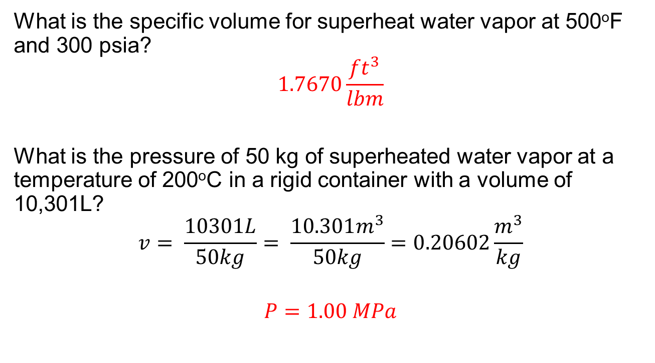
Example
What is the specific volume for superheat water vapor at 500ºF and 300 psia?
$$1.7670\frac{{ft}^{3}}{lbm}$$
What is the pressure of 50 kg of superheated water vapor at a temperature of 200ºC in a rigid container with a volume of 10,301L?
$$v= \frac{10301L}{50kg}= \frac{10.301m^{3}}{50kg}=0.20602\frac{m^{3}}{kg}$$
$$P=1.00 MPa$$

Slide 31
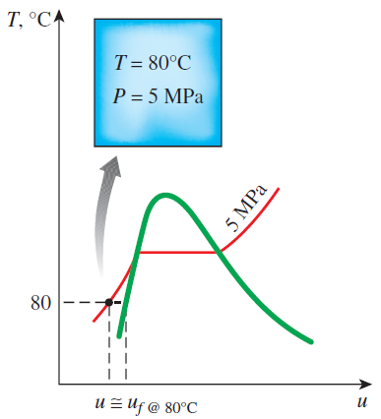
Compressed Liquid
The compressed liquid properties depend on temperature much more strongly than they do on pressure.
Compressed liquid is characterized by
y → v, u, or h
A more accurate relation for h
A compressed liquid may be approximated as a saturated liquid at the given temperature.

Slide 32
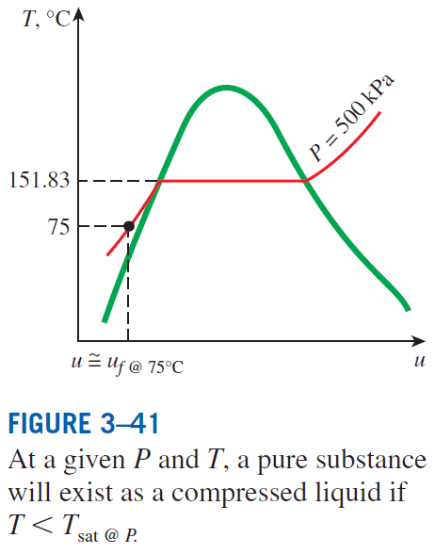

Slide 33
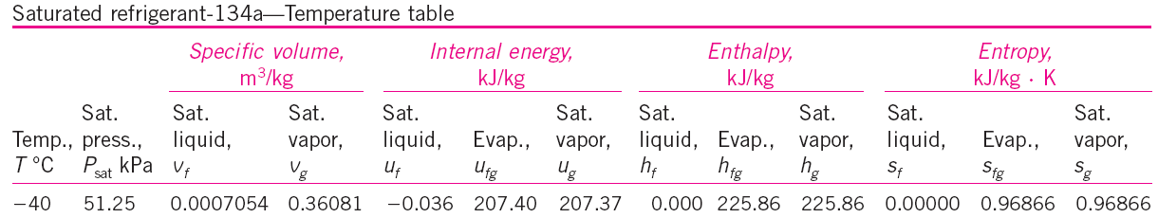
Reference State and Reference Values
The values of u, h, and s cannot be measured directly, and they are calculated from measurable properties using the relations between properties.
However, those relations give the changes in properties, not the values of properties at specified states.
Therefore, we need to choose a convenient reference state and assign a value of zero for a convenient property or properties at that state.
The reference state for water is 0.01°C and for R-134a is -40°C in tables.
Some properties may have negative values as a result of the reference state chosen.
Sometimes different tables list different values for some properties at the same state as a result of using a different reference state.
However, In thermodynamics we are concerned with the changes in properties, and the reference state chosen is of no consequence in calculations.

Slide 34
Summary
Pure substance
Phases of a pure substance
Phase-change processes of pure substances
Compressed liquid, Saturated liquid, Saturated vapor, Superheated vapor
Saturation temperature and Saturation pressure
Property diagrams for phase change processes
The T-v diagram, The P-v diagram, The P-T diagram, The P-v-T surface
Property tables
Enthalpy
Saturated liquid, saturated vapor, Saturated liquid vapor mixture, Superheated vapor, compressed liquid
Reference state and reference values

